Slide 1
DESI Visual
Inspection Training
(Round 2, Aug 2020)
Tamara Davis
Boris Gaensicke
Rita Tojeiro
Ting-Wen Lan

Slide 2
VISUAL INSPECTION IN DESI
These slides:
How does VI work and what are its goals?
Prospect - DESI’s VI tool.
Visually inspecting galaxies.
Visually inspecting quasars.
Visually inspecting stars.

Slide 3
VISUAL INSPECTION
Today’s session is about training you on:
the use of the spectral viewer,
the quality flags associated with visual inspection,
recognising typical features in optical spectra.
And you are looking at some real DESI data!

Slide 4
VI: WORKFLOW [ACTUAL EXPERIENCE MAY VARY]
VI leads prepare static html pages of targets for inspection. These may be indexed by night/pixel/magnitude/whatever.
Volunteers are allocated a page or section in the index.
Volunteers carry on the VI within a requested time-frame, download a text file with the VI results when they finish (see next), and email it or otherwise upload it somewhere for VI leads to access.
At the moment no NERSC access is required, though pages are password-protected (see https://desi.lbl.gov/trac/wiki/Computing/AccessNerscData for access)
Repeat. Repeat. Repeat.
Repeat.

Slide 5
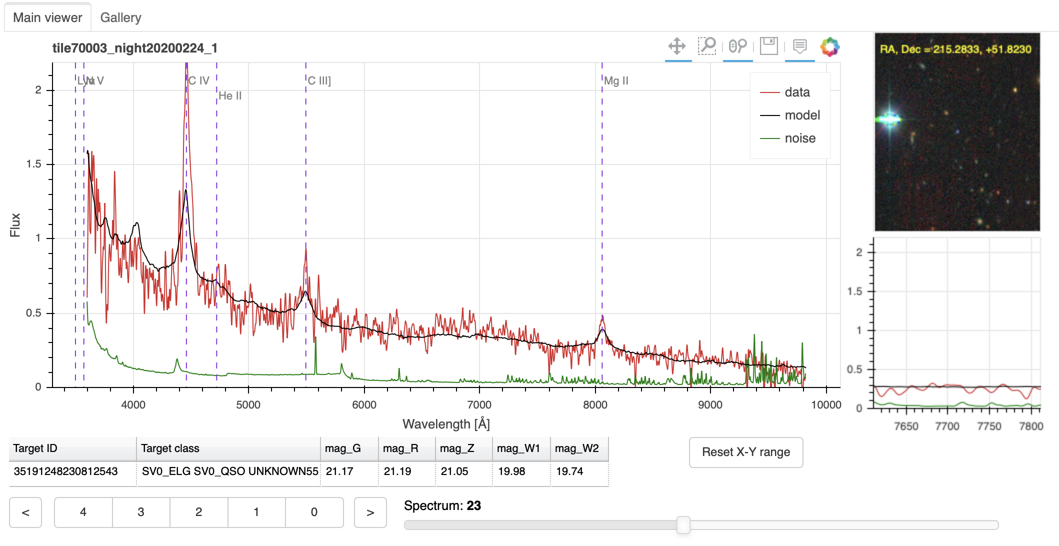
PROSPECT - DESI’S VI TOOL
Tools for the main view (box zoom,…)
Single-click to add/remove model/noise/data curves
VI flags (see later)
Can copy-paste (if you accidentally edit, no worry: no impact on VI)

Slide 6

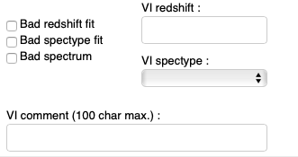
QUALITY FLAGS AND SPEC CLASSIFICATION
You will need to assign a classification flag to each spectrum (compulsory), and you may need to assign an optional indicator to some spectra.
These might end up in the truth table
Classification flags :
[ 4 ] Confident classification, two or more secure features
[ 3 ] Probable classification, at least one secure feature + continuum; or many weak features
[ 2 ] Possible classification, one strong emission feature, but not sure what it is
[ 1 ] Unlikely classification, one or some unidentified features
[ 0 ] Nothing there - no signal.
Optional indications :
[ Bad redshift fit (R) ] Misestimation of redshift by pipeline fitter
[ Bad spectype fit (C) ] Misidentification of spectral category by pipeline fitter, eg. star vs QSO...
[ Bad spectrum (S) ] Bad spectrum, eg. cosmic / skyline subtraction residuals...
These will end up in the truth table
These will not.

Slide 7
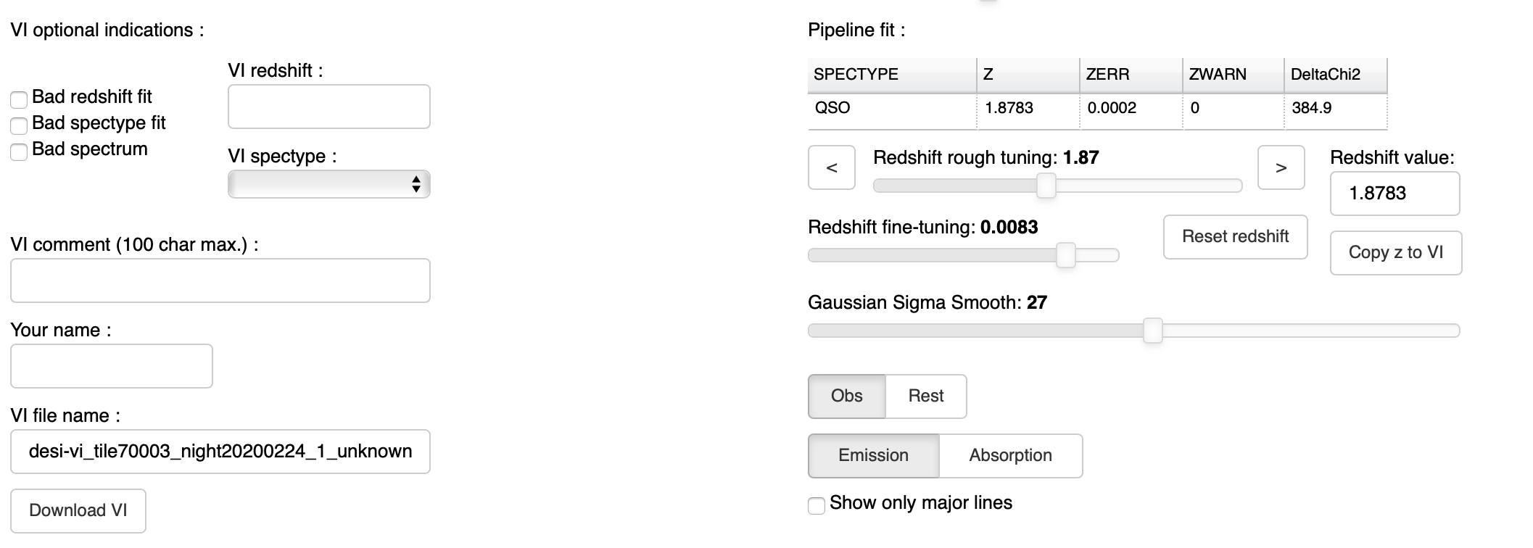
PROSPECT - DESI’S VI TOOL
Redrock output
Redshift widgets (rescales x-axis in viewer)
Reset: back to RR value
Copy to VI: for VI recording
Smoothing ~ 15 generally a good choice
Smoothing = 0 to see doublet
Show lines in main window
Entering VI information
main « VI flag » = ranking 4 - 0 (see guidelines)
- optional flags : bad spectrum, bad z, bad classification ;
- if VI flag == 4, not necessary to enter a VI redshift/spectype (agreement with pipeline fit results)
Saving VI information
- Enter your name once (eg 3-letter identifier) ; VI filename should be automatically assigned
- « Download VI » once you’re done with a given html page. A csv file is downloaded on your machine => send to VI leads.
- If you forgot to download, or go back to a previously-inspected set of spectra and wish to restore previous VI infos you entered : use « recover auto-saved VI » (VI info is stored in your browser through localStorage)

Slide 8
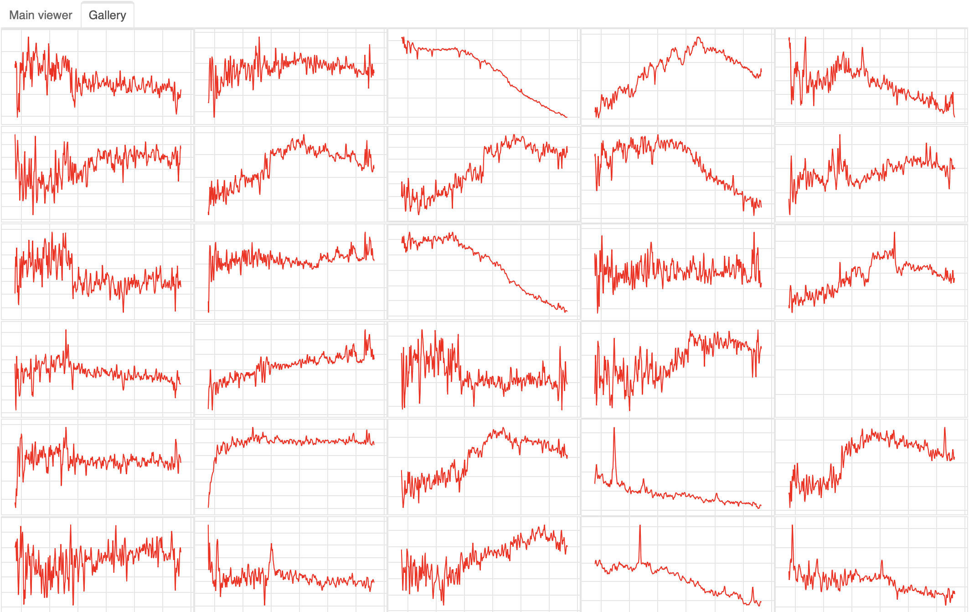
PROSPECT - DESI’S VI TOOL
Thumb gallery :
If in main html page (specviewer_*.html) : double-click on thumb to go to main viewer for a given spectrum.
If in light page (thumbs_*.html) : link on top of page to download main viewer

Slide 9
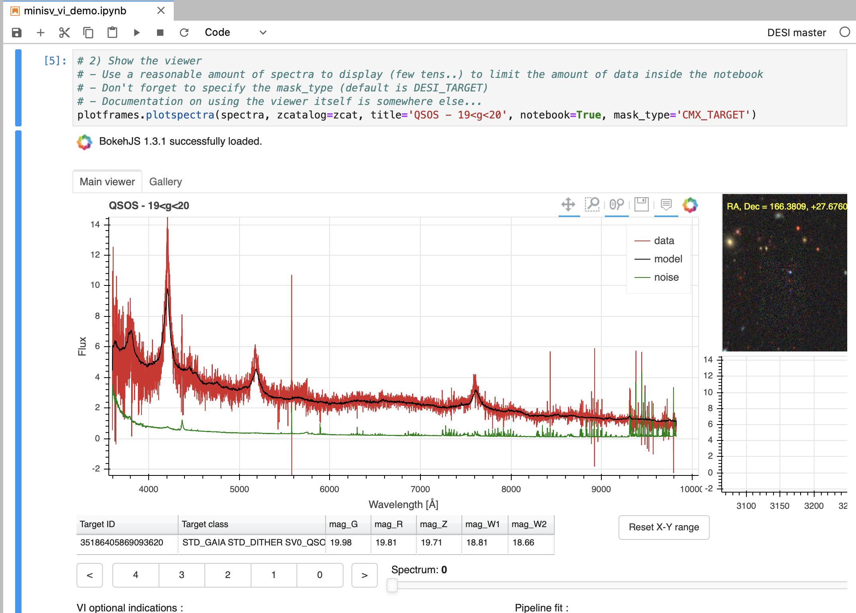
PROSPECT can also be used in a notebook
The same program (bokeh-based) makes HTML pages or VI interfaces embedded within notebooks
Requires basic knowledge of desi data structure and NERSC jupyter notebooks.
See examples in eg.
https://github.com/desihub/prospect/blob/minisv/doc/nb/minisv_vi_demo.ipynb (VI a selection of objects based on masks )
https://github.com/desihub/prospect/blob/minisv/doc/nb/Prospect_targetid.ipynb (VI a list of targetids)
If you have a set of (custom) spectra, and optionally associated redrock output ZBEST table zcat then creating a VI interface is a single command
help(plotframes.plotspectra) to know available options

Slide 10
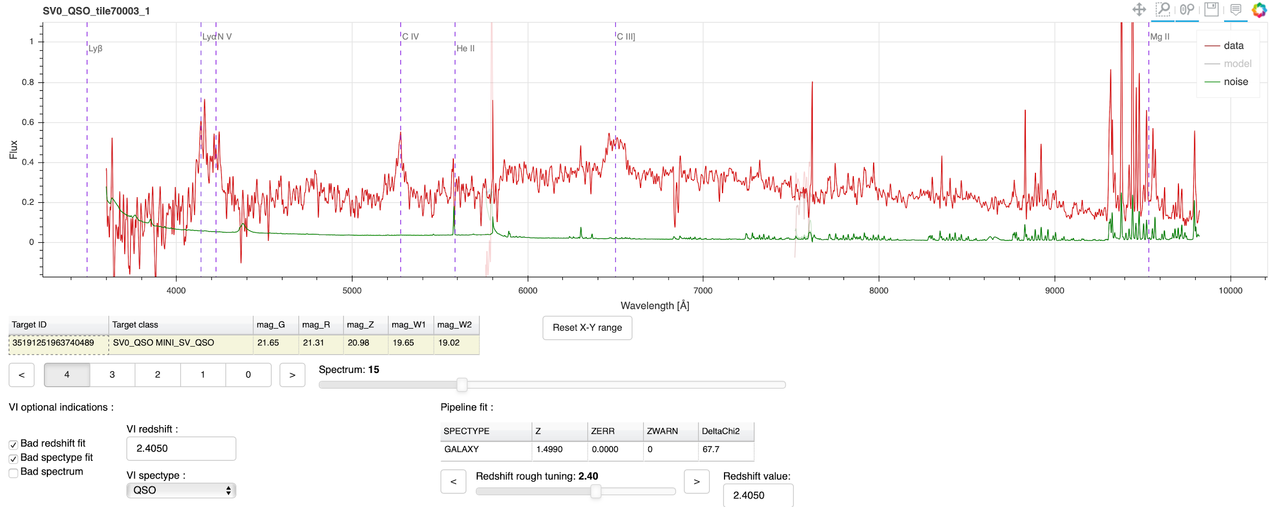
VISUALLY INSPECTING QUASARS: EXAMPLES
...yey! The broad lines match a clear pattern for a QSO at z~2.4.

Slide 11
OPTICAL SPECTRA
A correct redshift will usually be evident by the fact that strong, identifiable features appear in the correct place, in the rest-frame of the target. Sometimes, you’ll have to rely on many, but weaker features.
The next slides offer a quick introduction to those unfamiliar with optical spectra, and gives examples of features that you should expect to identify in DESI spectra, as well as general tips and hints.
When looking at spectra, especially if it’s not full Mini-SV2 depth, some (or many) of these features will only be apparent once you’ve smoothed the spectra (the key exception is the [OII] doublet!).
Remember that the templates aren’t meant to be perfect - if the shape of a feature doesn’t match the data well (say, line strength, or line width), that’s OK, provided it’s in the right place.

Slide 12
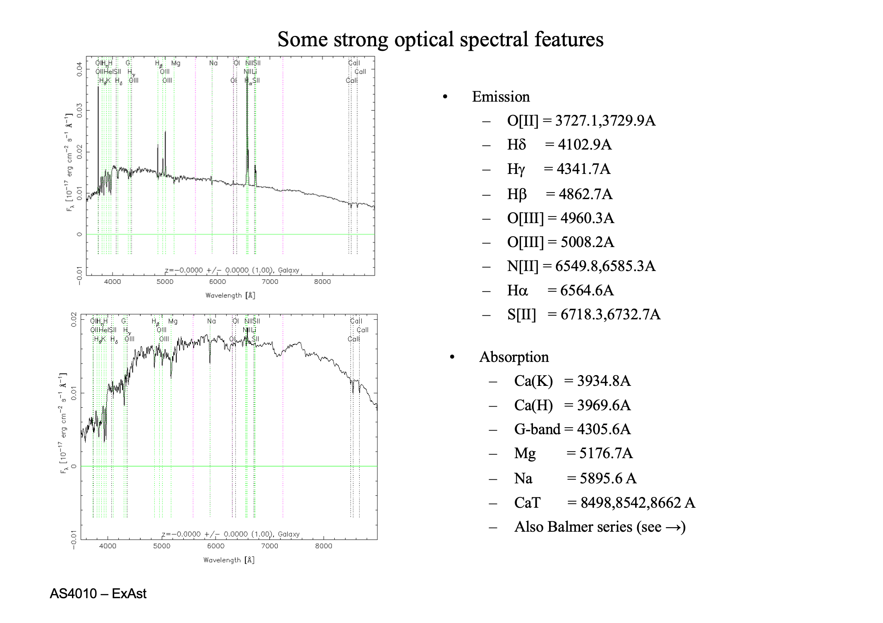
OPTICAL SPECTRA 101 - GALAXIES
Some typical, and frequent, absorption and emission features in optical spectra of galaxies.
Many BGS and almost all ELG targets will show strong emission lines, and often strong Balmer lines in absorption as well as emission. At nominal depth, you will rarely see a continuum for ELGs.
Very few LRGs will show strong emission lines, but they have a strong break in the continuum at 4000A and often sharp H&K lines in absorption.

Slide 13

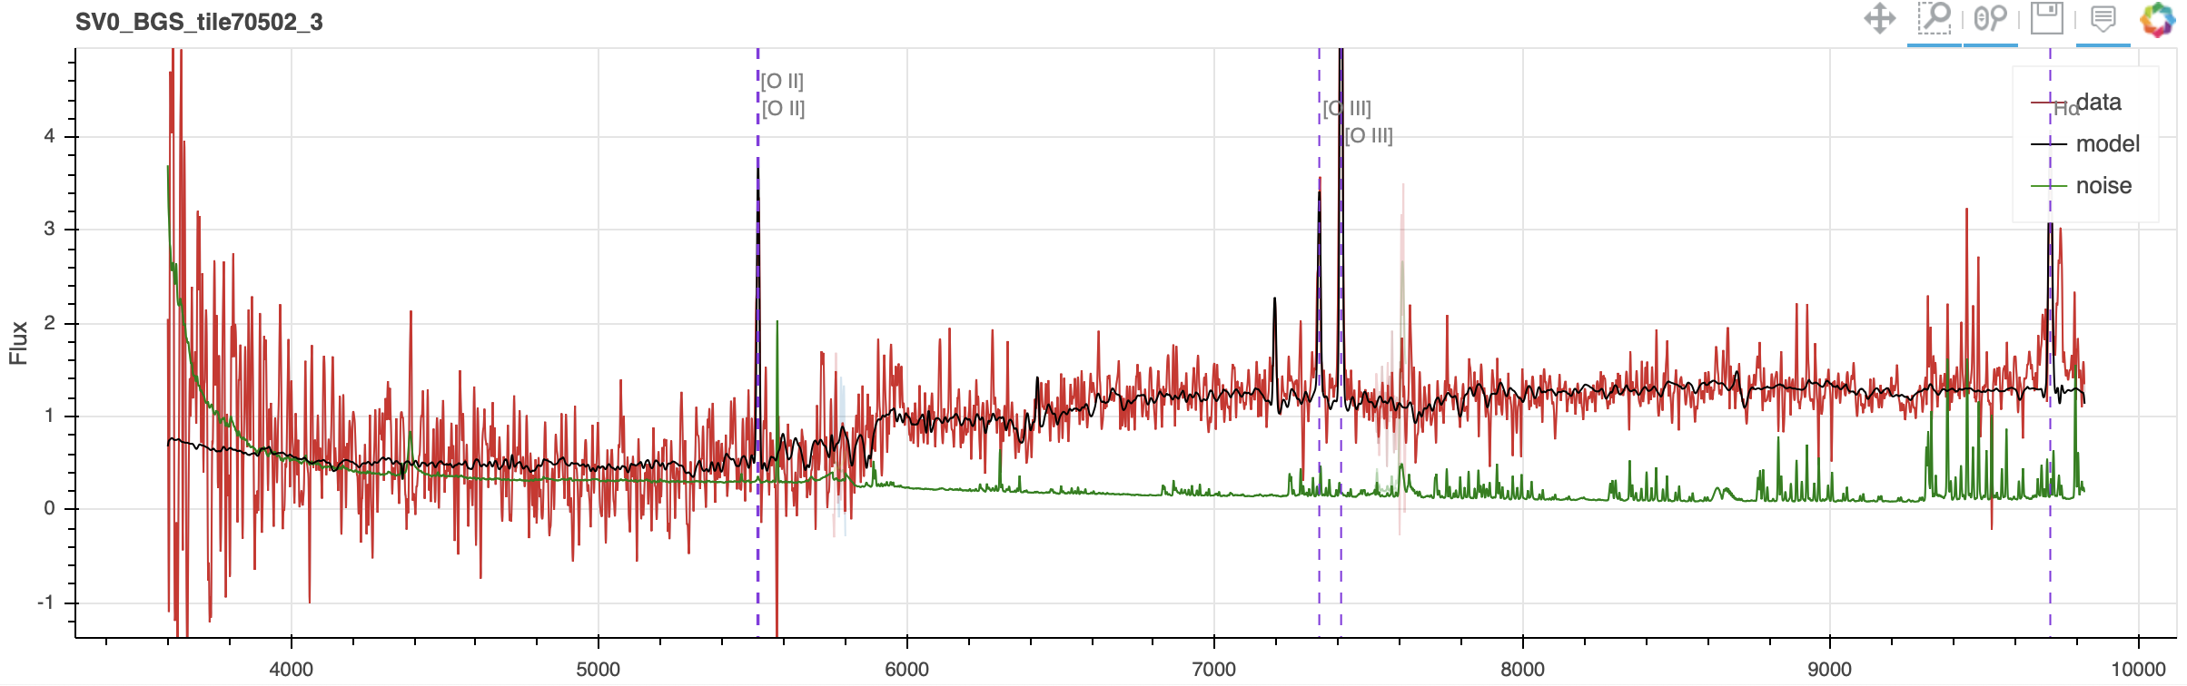
INSPECTING GALAXIES: EXAMPLES
Emission lines?
Look for: [OII] (doublet, sometimes resolved), Ha, Hb, [OIII] (two lines)
Balmer lines redwards of [OII] in absorption
Change in continuum amplitude to either side of [OII]
Secure redshifts
(star-forming galaxies)
After smoothing
2 or more secure features -> secure redshift.

Slide 14
YOUR WORKFLOW
Does the spectrum look bad? I.e., big gaps, big jumps, anything that looks unphysical or unusual?
If yes, tick “Bad spectrum”, and give details on the VI comment. If the issues are bad enough that you can’t assess the redshift, mark flag=0 and move to the next spectrum.
Else, carry on to spectral classification.
Is the spectral classification by the pipeline correct?
If no, tick “Bad spectype fit”, and select the correct spectype from the dropdown menu. Carry on to redshift inspection.
Else, carry on to redshift inspection.
Redshift inspection.
Does the redshift look correct?
If yes, provide a confidence flag. Move on to the next spectrum.
If no:
Can you determine the correct redshift by inspection?
If yes, tick “Bad redshift fit”, and provide your VI estimate in “VI redshift”. Provide a confidence flag. Move on to the next spectrum.
If no, give flag 0. Move on to next spectrum.

Slide 15
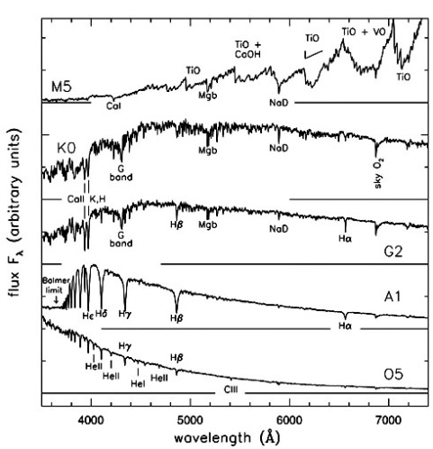
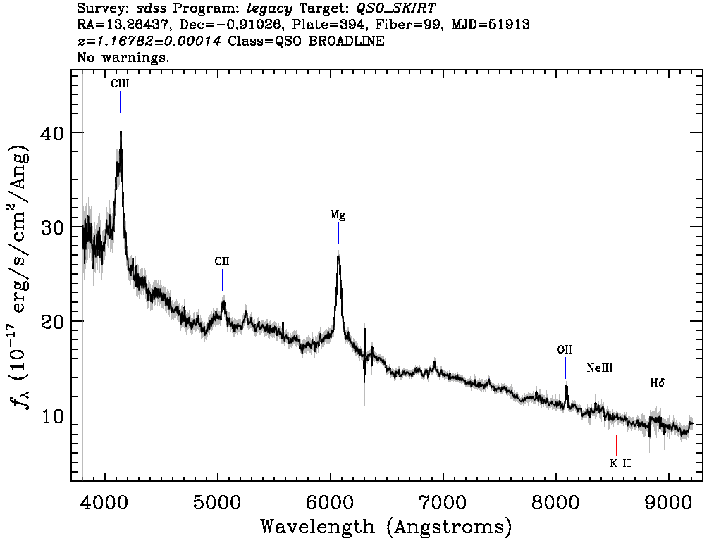
VISUALLY INSPECTING GALAXIES
Contaminants in the form of quasars and stars are common. In an ideal world, redrock will correctly identify the spectral type, but sometimes it doesn’t.
Identify low mass stars by the large, molecular bands in absorption. Other stars will be easily spotted by being at z=0!
Identify quasars by broad lines in emission (or absorption), or high-excitation narrow lines.
If you’re confident about a QSO redshift, still flag it as 4, even it it was targeted as a galaxy. If you’re not confident, flag it as 1.

Slide 16
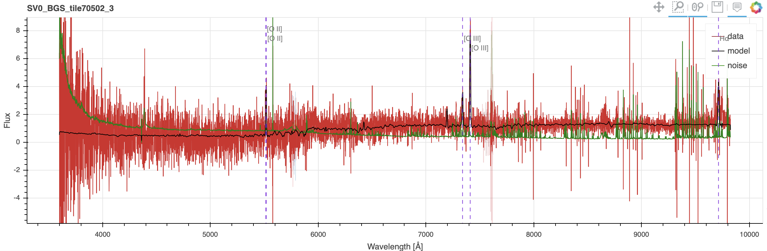
INSPECTING GALAXIES: EXAMPLES
Emission lines?
Look for: [OII] (doublet, sometimes resolved), Ha, Hb, [OIII] (two lines)
Balmer lines redwards of [OII] in absorption
Change in continuum amplitude to either side of [OII]
Secure redshifts
(star-forming galaxies)

Slide 17
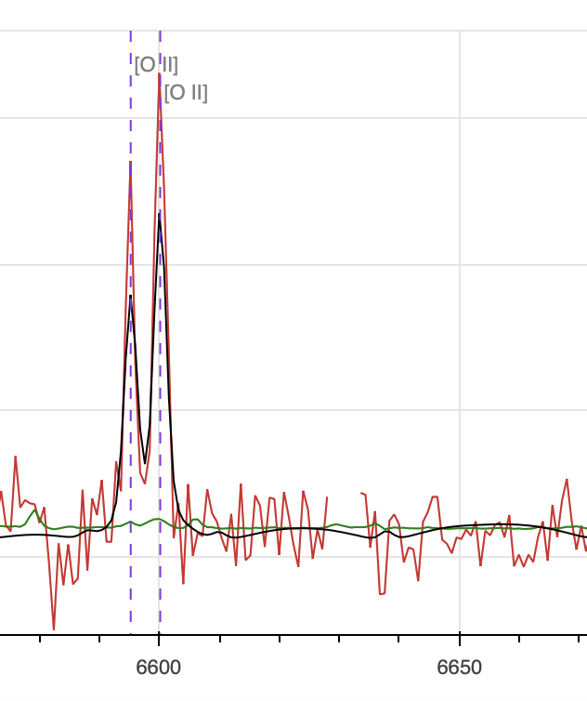
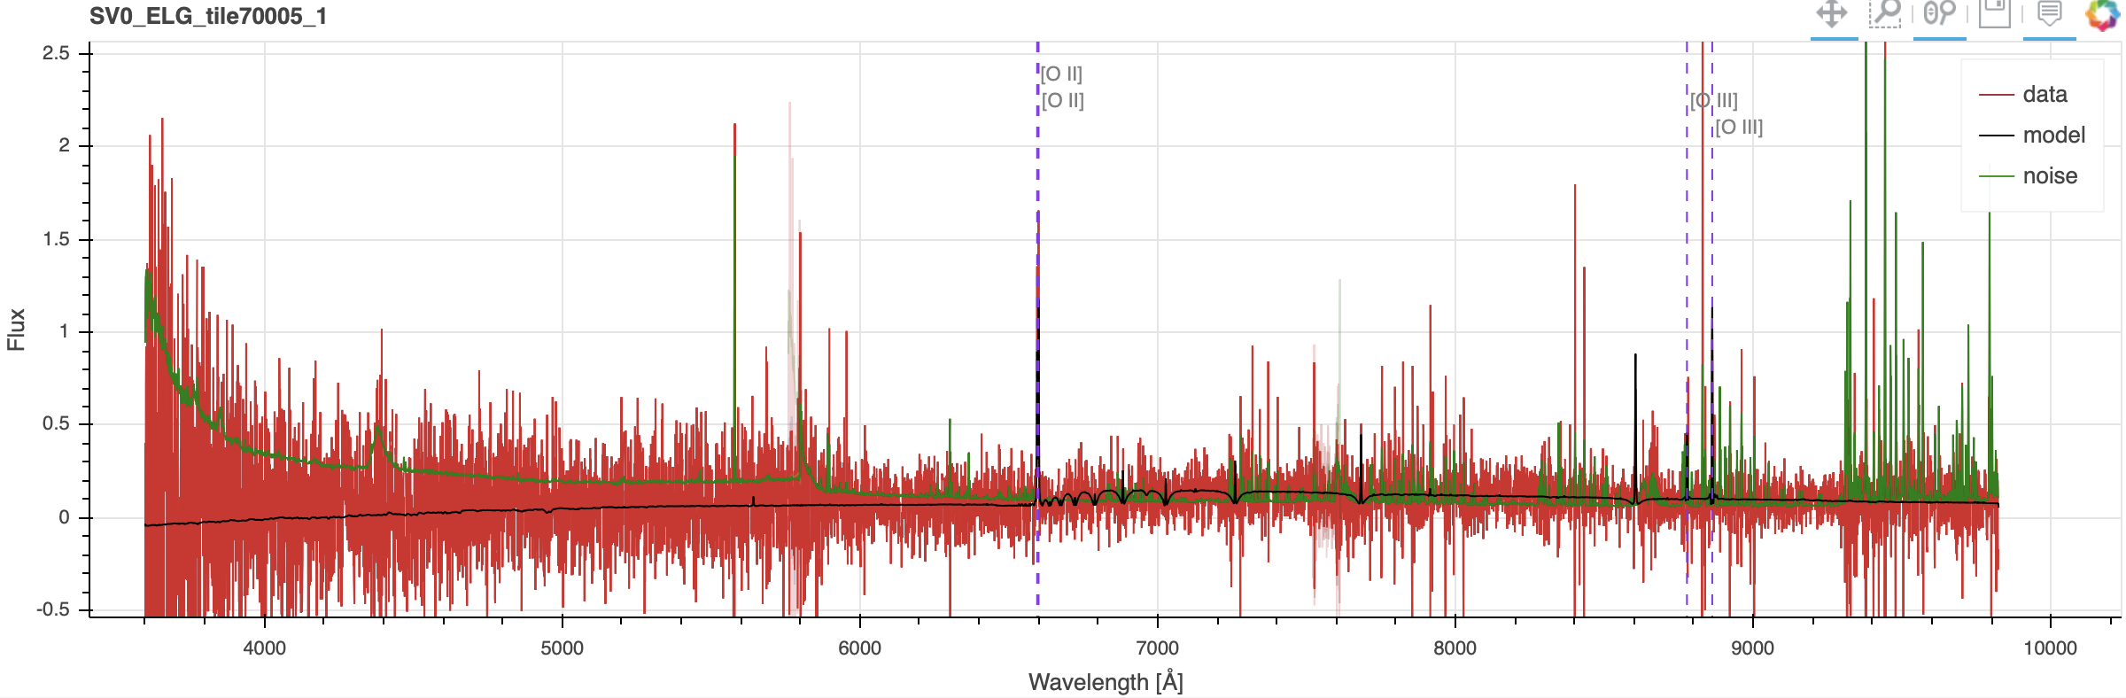
INSPECTING GALAXIES: EXAMPLES
Secure redshifts
[OII] doublet
Occasionally, you won’t have a continuum, and only 1 emission line. If the [OII] doublet is resolved, the redshift is secure.

Slide 18
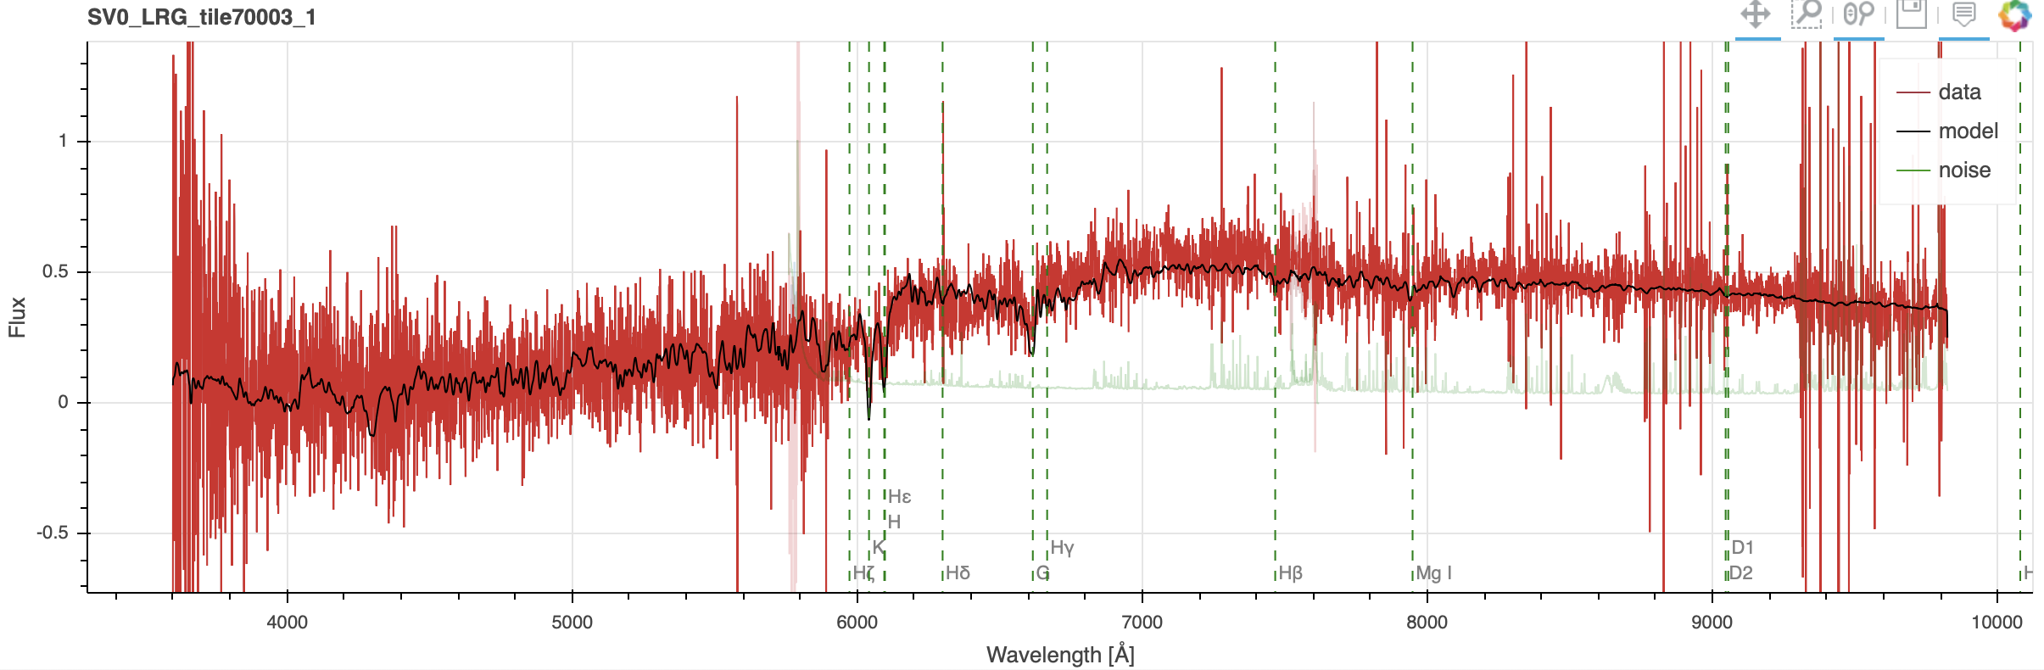
INSPECTING GALAXIES: EXAMPLES
Look for: H&K lines and continuum break.
Broad features around MgI, G-band.
Strong Hb, NaI absorption.
Watch out for a Balmer break sometimes looking like a 4000AA break.
Secure redshifts (passive)

Slide 19
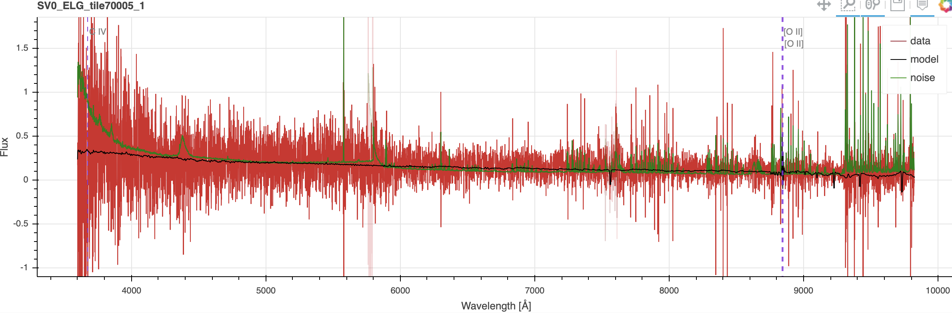
INSPECTING GALAXIES: EXAMPLES
Harder (low SNR/featureless)

Slide 20
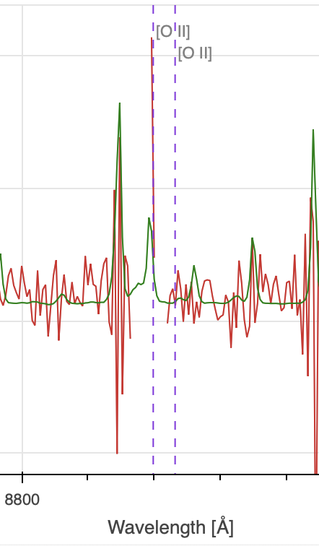
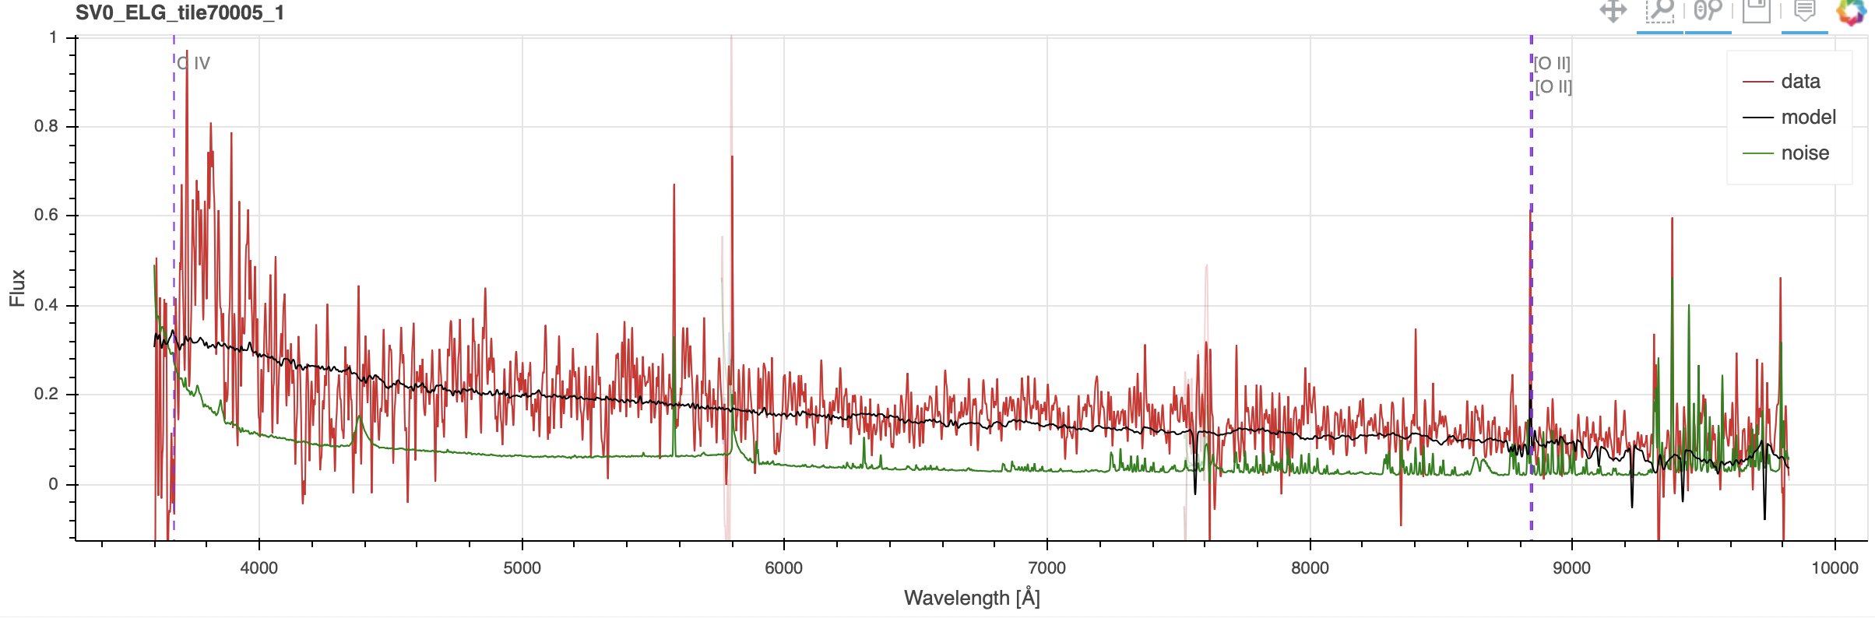
INSPECTING GALAXIES: EXAMPLES
There is signal, but no strong features.
No secure line detection
No secure redshift.
(low SNR/featureless)

Slide 21
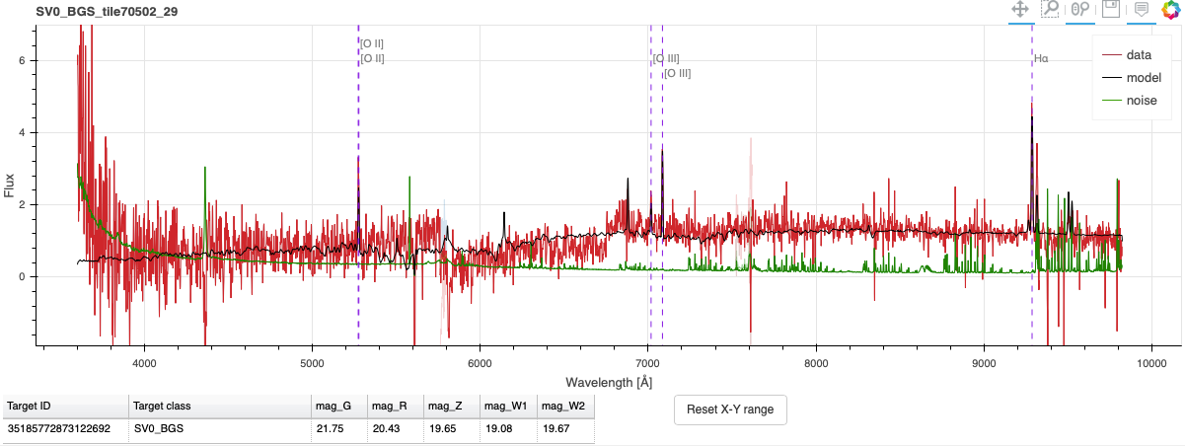
INSPECTING GALAXIES: EXAMPLES
Bad spectrum but z secure.
Big gaps, big jumps, anything that looks unphysical or unusual

Slide 22
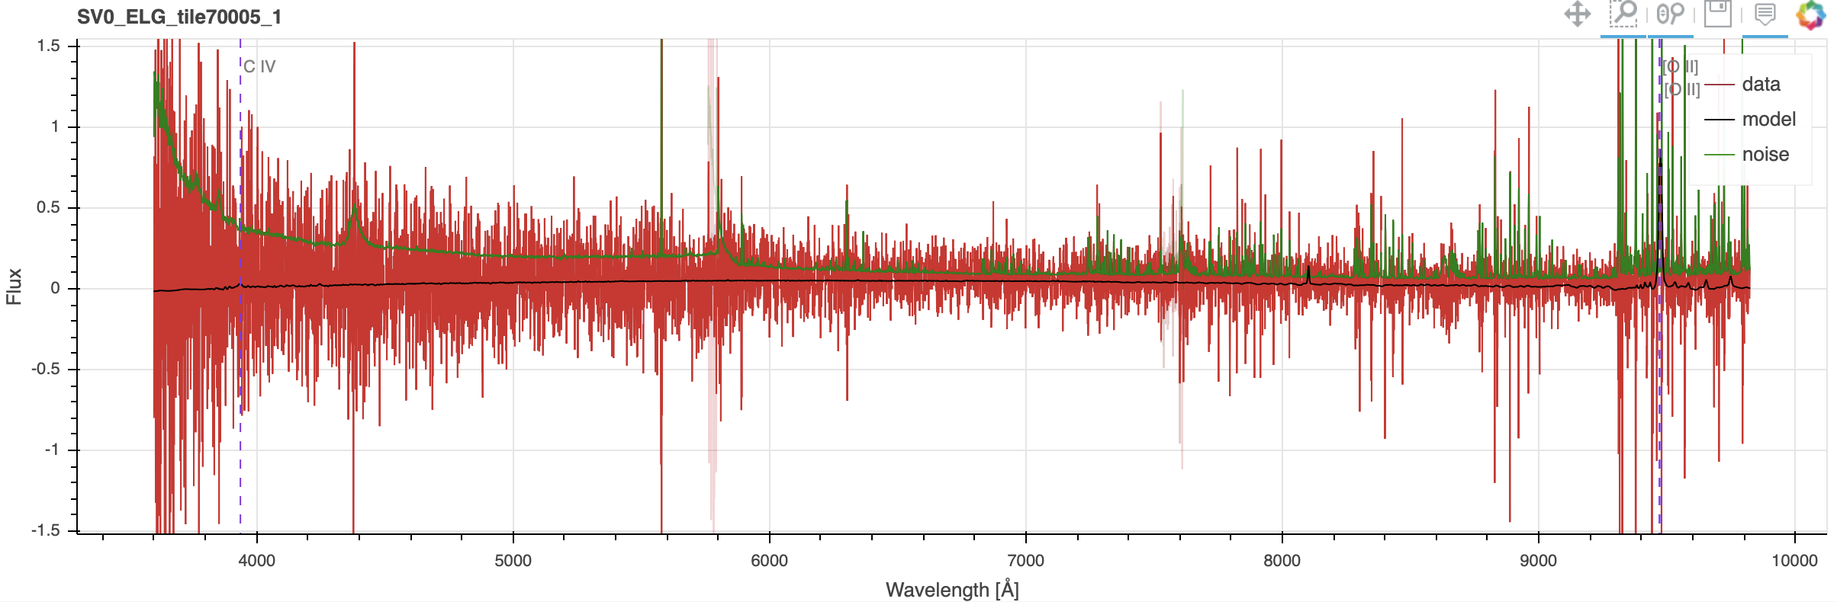
INSPECTING GALAXIES: EXAMPLES
No signal (flag = 0)
No signal - no features, data consistent with noise.

Slide 23
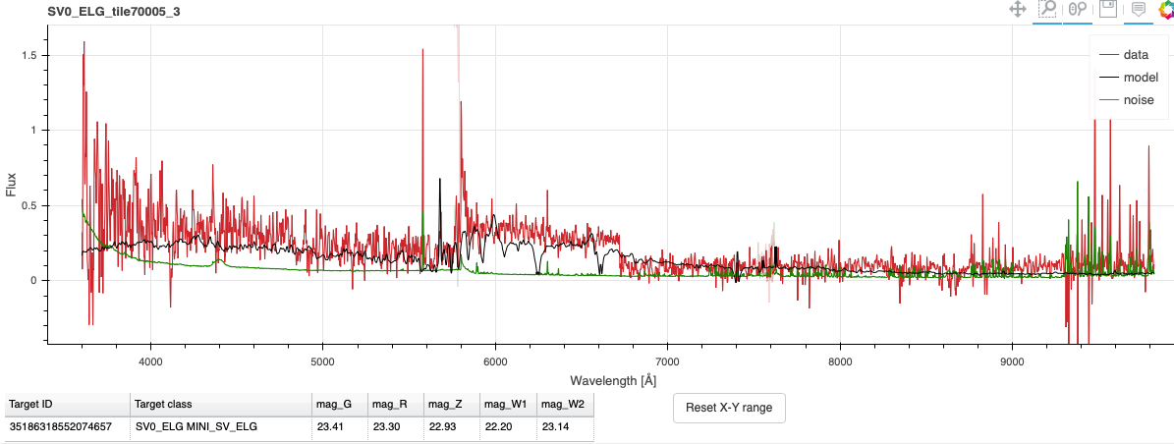
INSPECTING GALAXIES: EXAMPLES
Bad spectrum and flag = 1
Big gaps, big jumps, anything that looks unphysical or unusual

Slide 24
VISUALLY INSPECTING QUASARS
Most important: The lines always come together, if you see one big broad line, but not the others you expect, then it is not a good redshift.
Because of outflows etc... the lines won’t always be at the same redshift. Choose lower ionisation lines (Mg II over C IV, for example) as the better redshift.
Broad absorption lines (BAL) will be mostly on the blue wing of lines.
Be aware that the sims that redrock is trained on don’t have many of the complications real data will have (like BAL and damped Lyman-alpha)
Expect a lot of contamination from stars and star forming galaxies.
Lya VI page: https://desi.lbl.gov/trac/wiki/LymanAlphaWG/VisualInspection

Slide 25
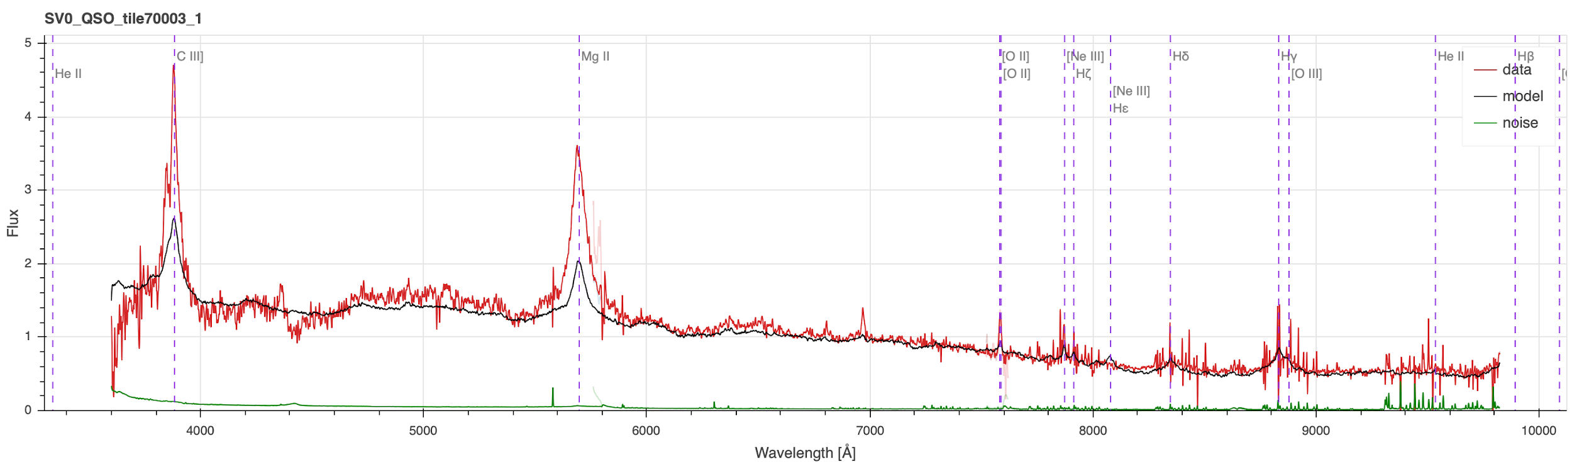
VISUALLY INSPECTING QUASARS: EXAMPLES
Beautiful z~1 quasar, showing the broad emission lines.
The lines that will always be there are Mg II, C III,
and at higher redshifts C IV, Lyman-alpha.

Slide 26
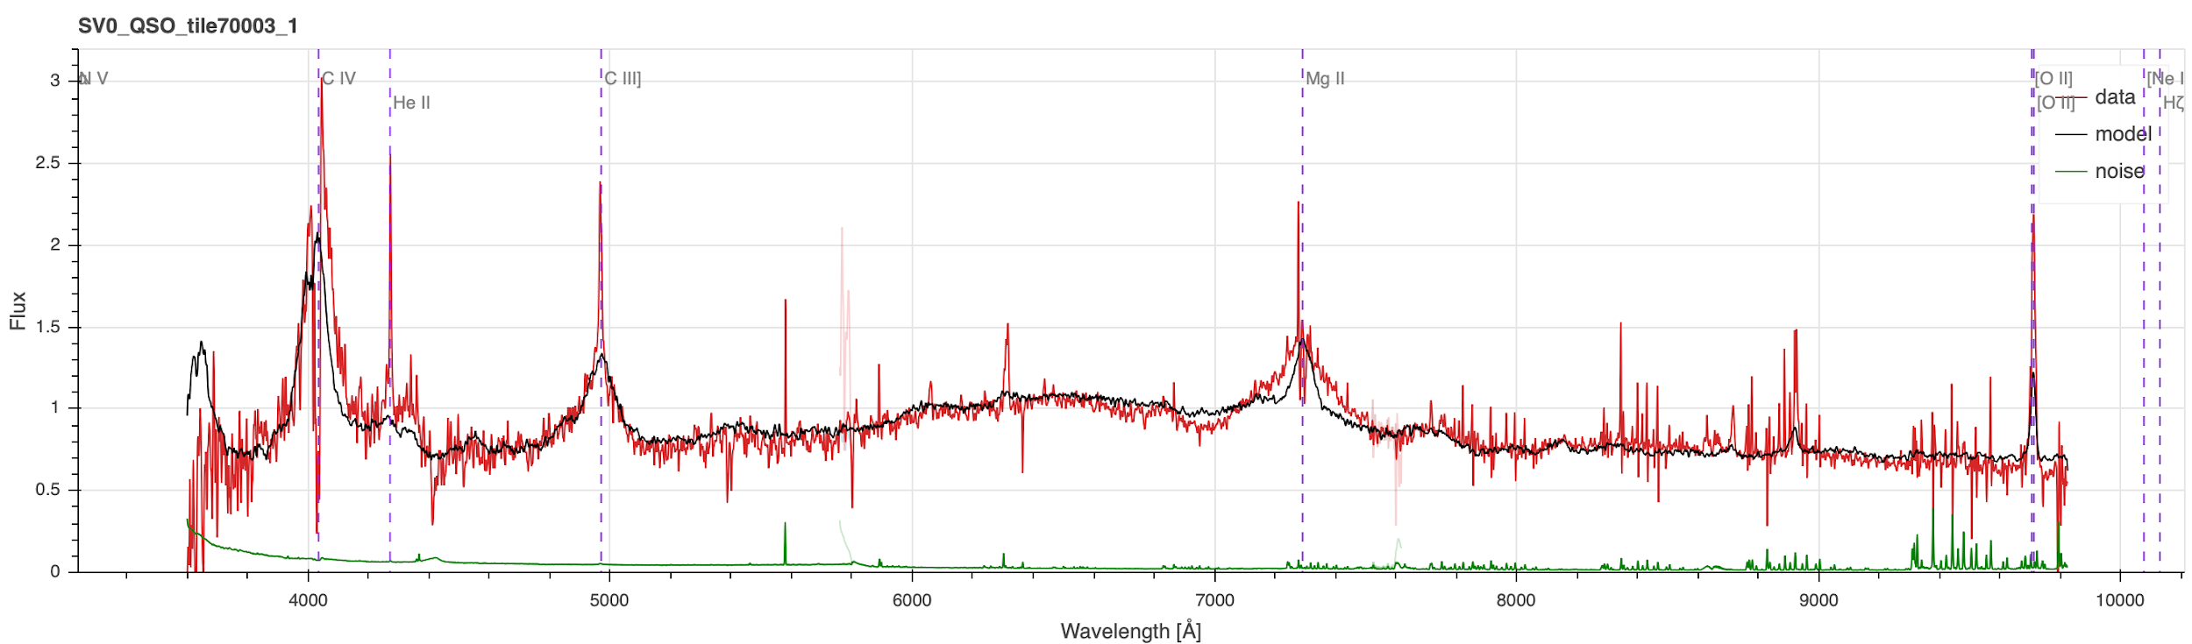
VISUALLY INSPECTING QUASARS: EXAMPLES
Another beautiful QSO, this time z~1.6. Now can see C IV as well.
This time O II is stronger - note that often the O II will not be broadened.

Slide 27
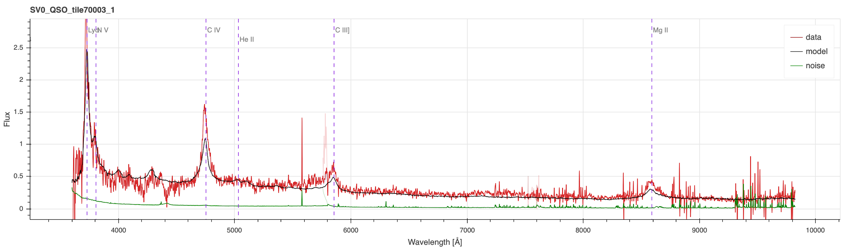
VISUALLY INSPECTING QUASARS: EXAMPLES
And by z~2.0 you get Lyman-alpha as well.
The sharp drop to the blue of Lyman-alpha is the Lyman break, which can be very distinctive.
Higher redshifts than this and you may see Lyman-beta, but not too much else.

Slide 28
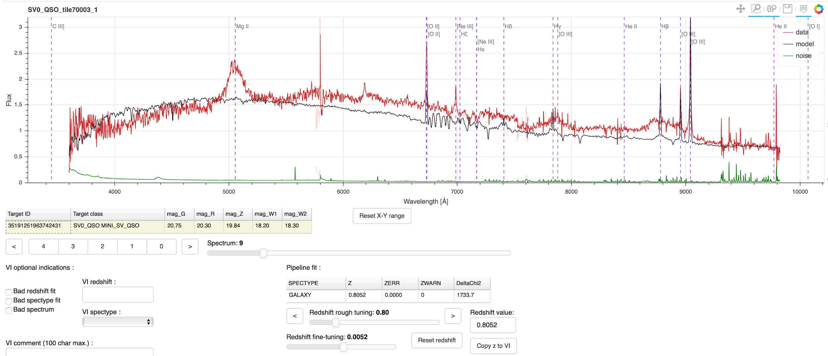
VISUALLY INSPECTING QUASARS: EXAMPLES
This one was identified as a galaxy, and the model doesn’t have Mg II emission. It is the correct redshift, though, and you can see all the O II, Hbeta, OIII lines of a normal galaxy. However, it also has a broad Mg II in the correct place, so I’d mark it as a QSO.

Slide 29
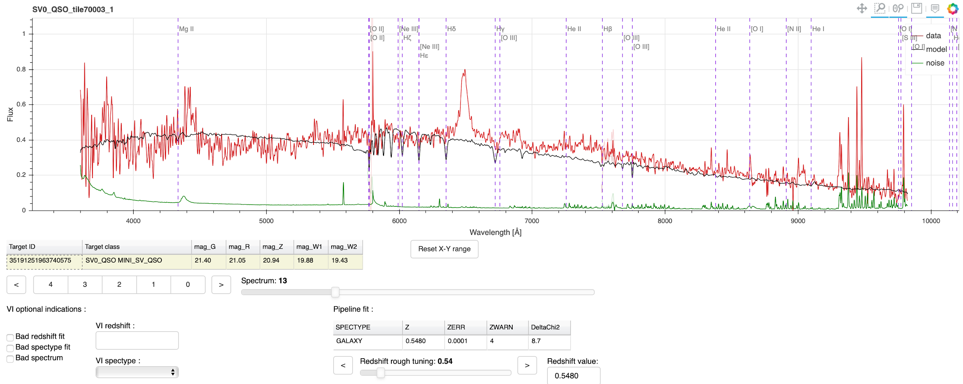
VISUALLY INSPECTING QUASARS: EXAMPLES
This is an example of a bad failure by redrock. Clearly a quasar (see next page for correct fit) but fit as a galaxy.

Slide 30
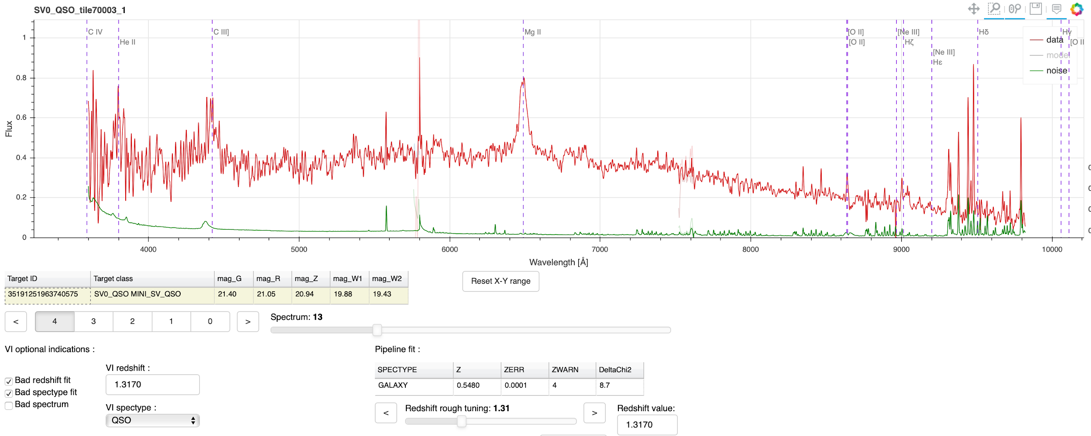
VISUALLY INSPECTING QUASARS: EXAMPLES
This is the correct redshift for the bad fit on the previous page. Mg II and C III both match, and O II as well.
Flagged “Bad redshift fit”, “Bad spectype fit”, corrected the z to 1.3170 and corrected the spectype to QSO.

Slide 31
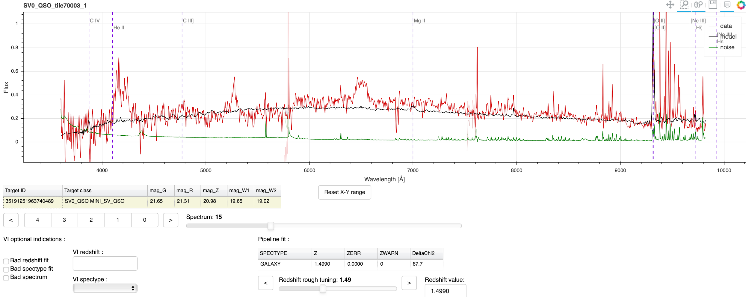
VISUALLY INSPECTING QUASARS: EXAMPLES
This is another bad fit and classification. It focused on the O II line, but note that strong double-peaked line is right above a noise double-peak, and all the sky lines up above 9000A have been poorly subtracted. The broad lines at lower wavelengths are more convincing… let’s see if they match...

Slide 32
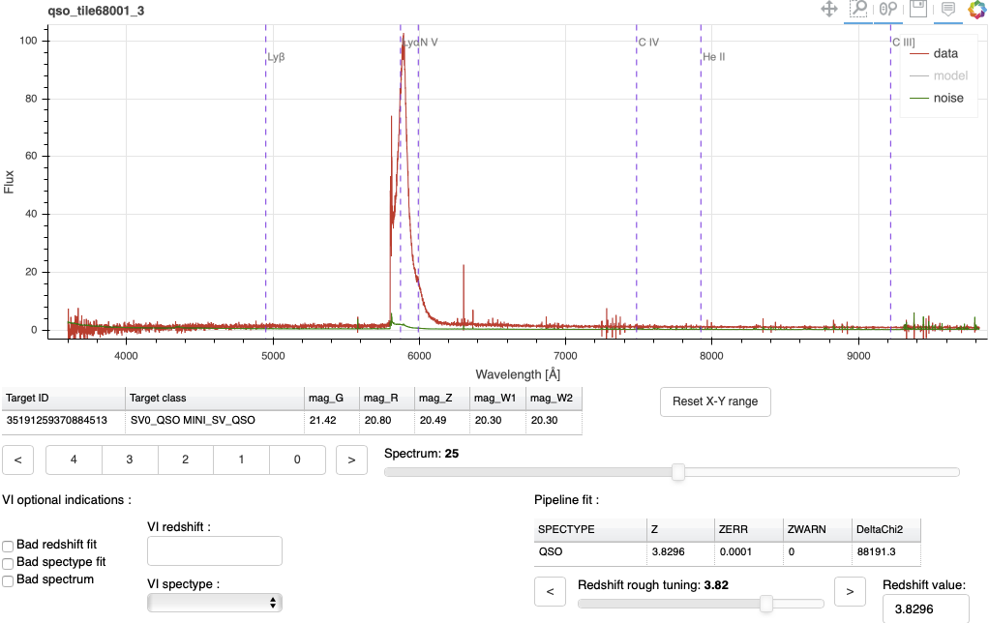
VISUALLY INSPECTING QUASARS: EXAMPLES
Whoops! This is NOT a quasar. This is a BAD SPECTRUM. That big broad “line” is a bad merging of the spectral arms. Note that it occurs right on the gap between green and blue (see noise spectrum below it). Absence of other lines like CIV and CIII are strong indicators that it is not a quasar at this z.

Slide 33
VISUALLY INSPECTING STARS
(most) stars do not have emission lines, hence classification is based on both overall spectral shape, and absorption line features.
The most useful features are the relatively sharp Ca H/K doublet (3968/3933A) if F/G-type stars, the broad triangular shaped Mg b-band (5183A) in K-type stars, and the broad VO and TiO molecular bands in cool M-dwarfs … examples on the next slides.

Slide 34
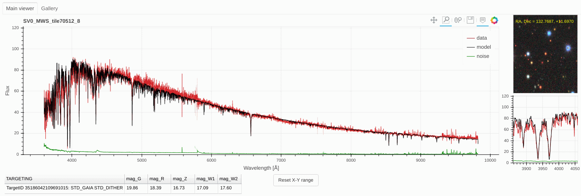
VISUALLY INSPECTING STARS: F-TYPE STAR
Ca H/K lines

Slide 35
VISUALLY INSPECTING STARS: F-TYPE STAR
Ca H/K lines

Slide 36
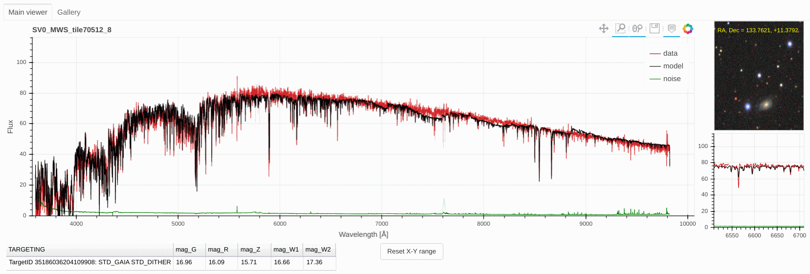
VISUALLY INSPECTING STARS: K-TYPE STAR
Mg b-band

Slide 37
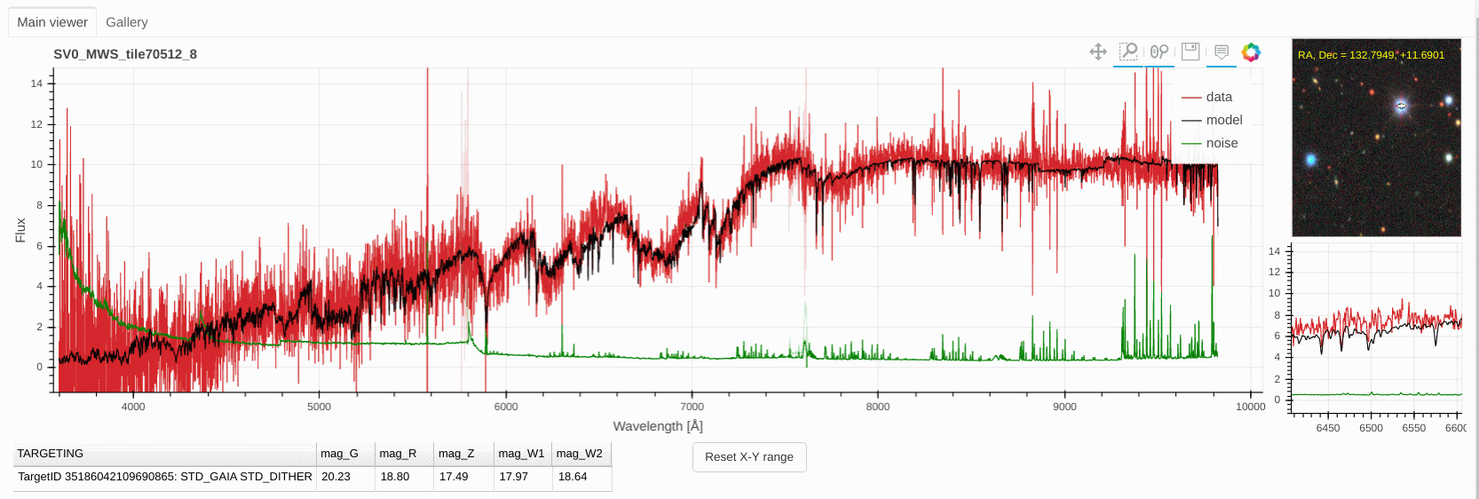
VISUALLY INSPECTING STARS: M-TYPE STAR
VO/TiO bands

Slide 38
VISUALLY INSPECTING STARS
(most) stars do not have emission lines, hence classification is based on both overall spectral shape, and absorption line features.
The most useful features are the relatively sharp Ca H/K doublet (3968/3933A) if F/G-type stars, the broad triangular shaped Mg b-band (5183A) in K-type stars, and the broad VO and TiO molecular bands in cool M-dwarfs … examples on the next slides
We do target white dwarfs as flux standards, which stand out by broad Balmer lines, and are blue dots in the imaging

Slide 39
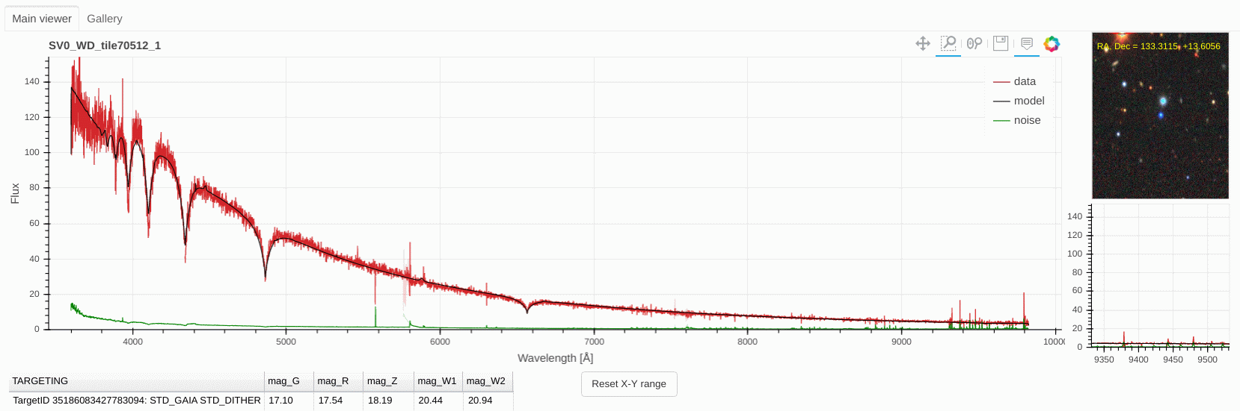
VISUALLY INSPECTING STARS: WHITE DWARFS
Balmer lines
Very blue

Slide 40
VISUALLY INSPECTING STARS
(most) stars do not have emission lines, hence classification is based on both overall spectral shape, and absorption line features.
The most useful features are the relatively sharp Ca H/K doublet (3968/3933A) if F/G-type stars, the broad triangular shaped Mg b-band (5183A) in K-type stars, and the broad VO and TiO molecular bands in cool M-dwarfs … examples on the next slides
We do target white dwarfs as flux standards, which stand out by broad Balmer lines, and are blue dots in the imaging
Problems: some are easy to spot, e.g. multiple stars in the fiber

Slide 41
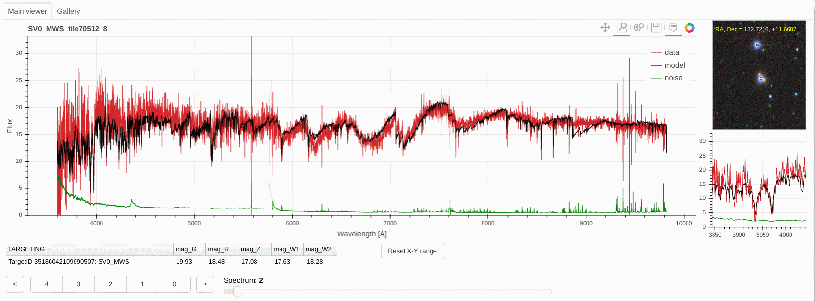
VISUALLY INSPECTING STARS: Blended F & M-TYPE STAR

Slide 42
VISUALLY INSPECTING STARS
(most) stars do not have emission lines, hence classification is based on both overall spectral shape, and absorption line features.
The most useful features are the relatively sharp Ca H/K doublet (3968/3933A) if F/G-type stars, the broad triangular shaped Mg b-band (5183A) in K-type stars, and the broad VO and TiO molecular bands in cool M-dwarfs … examples on the next slides
We do target white dwarfs as flux standards, which stand out by broad Balmer lines, and are blue dots in the imaging
Problems: some are easy to spot, e.g. multiple stars in the fiber
Problems: at low S/N, telling apart low-z passive galaxies and coolish stars becomes tricky

Slide 43
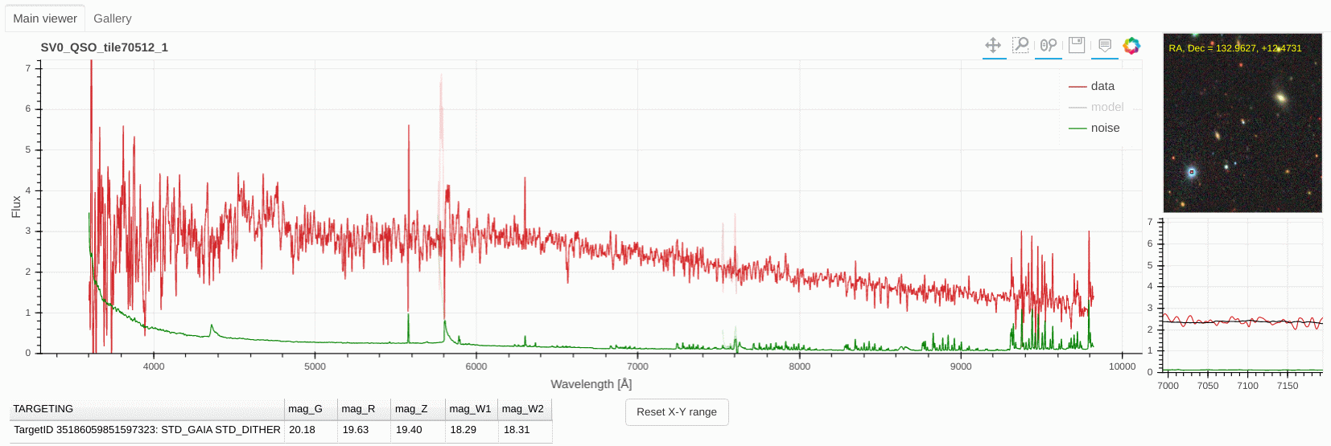
VISUALLY INSPECTING STARS: LOW S/N PLUS BLENDING

Slide 44
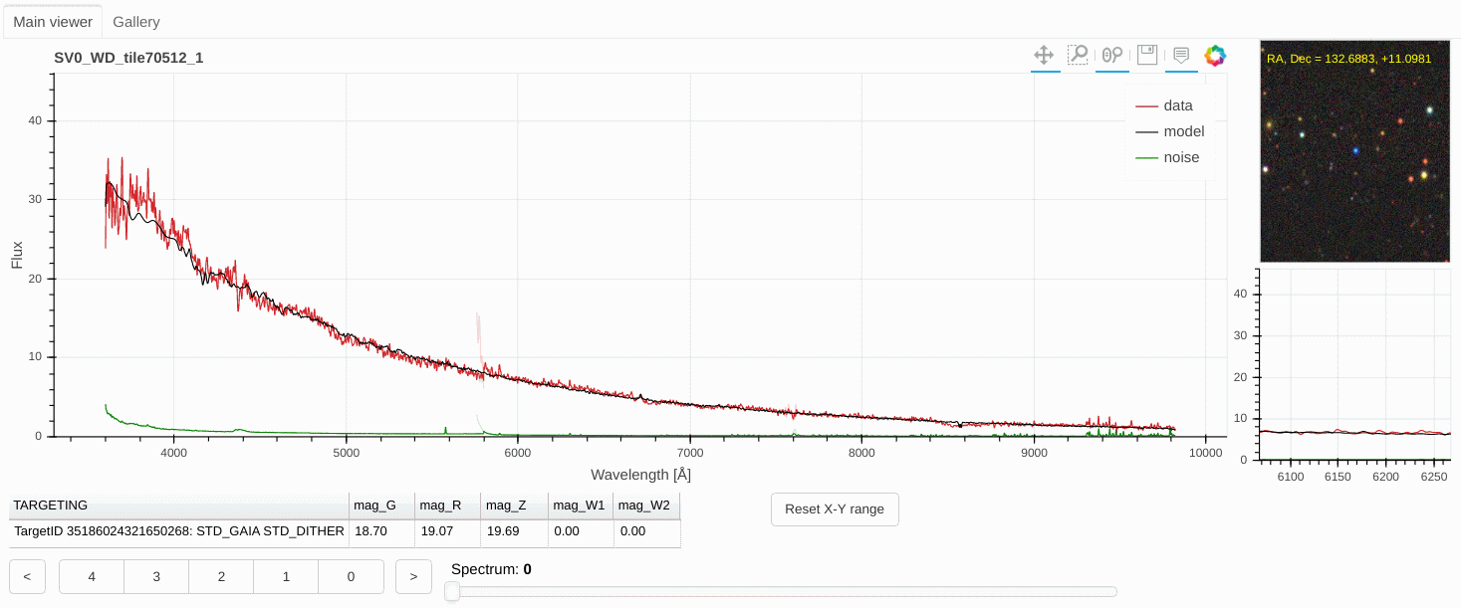
VISUALLY INSPECTING STARS: MAGNETIC WD CLASSIFIED AS GALAXY

Slide 45
VISUALLY INSPECTING STARS
(most) stars do not have emission lines, hence classification is based on both overall spectral shape, and absorption line features.
The most useful features are the relatively sharp Ca H/K doublet (3968/3933A) if F/G-type stars, the broad triangular shaped Mg b-band (5183A) in K-type stars, and the broad VO and TiO molecular bands in cool M-dwarfs … examples on the next slides
We do target white dwarfs as flux standards, which stand out by broad Balmer lines, and are blue dots in the imaging
Problems: some are easy to spot, e.g. multiple stars in the fiber
Problems: at low S/N, telling apart low-z passive galaxies and coolish stars becomes tricky
… and there are quite a few odd stars out there!

Slide 46
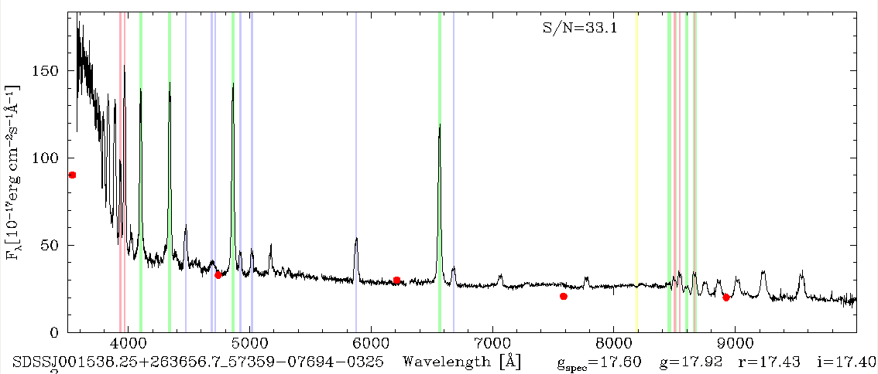
VISUALLY INSPECTING STARS: ODDBALLS
:
Interacting binary

Slide 47
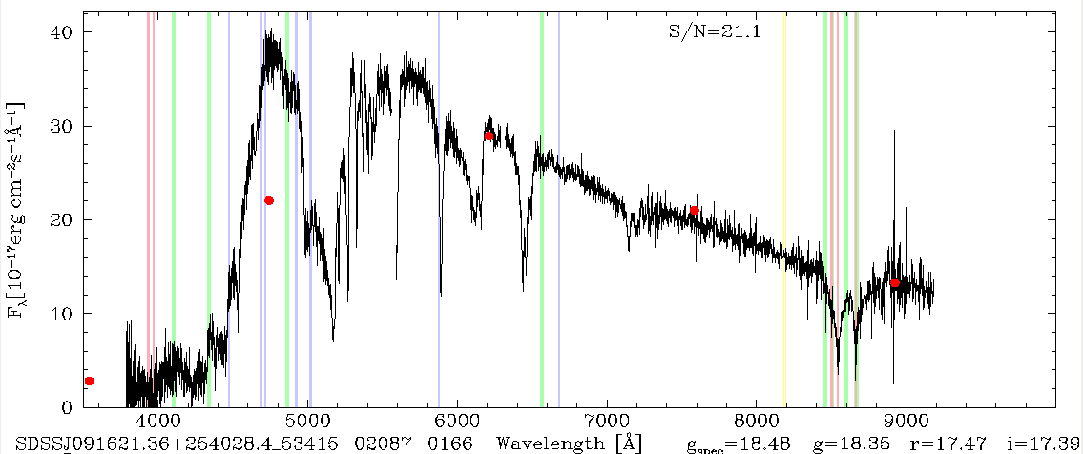
VISUALLY INSPECTING STARS: ODDBALLS
:
Metal-rich WD

Slide 48
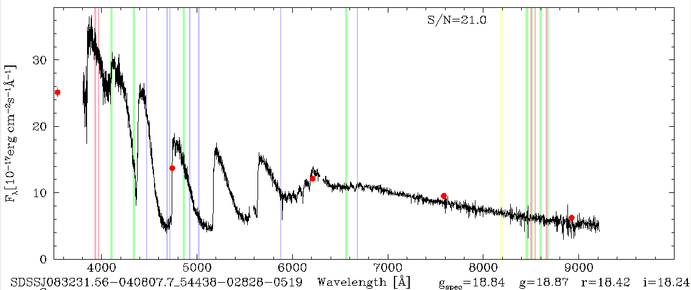
VISUALLY INSPECTING STARS: ODDBALLS
:
C-rich WD

Slide 49
VISUALLY INSPECTING FAILURES
Some “features” you see in the spectra are really just failures of calibration
Also, Redrock often picks unphysical models.
Here’s some examples of failures, or “false features”, to watch out for.

Slide 50
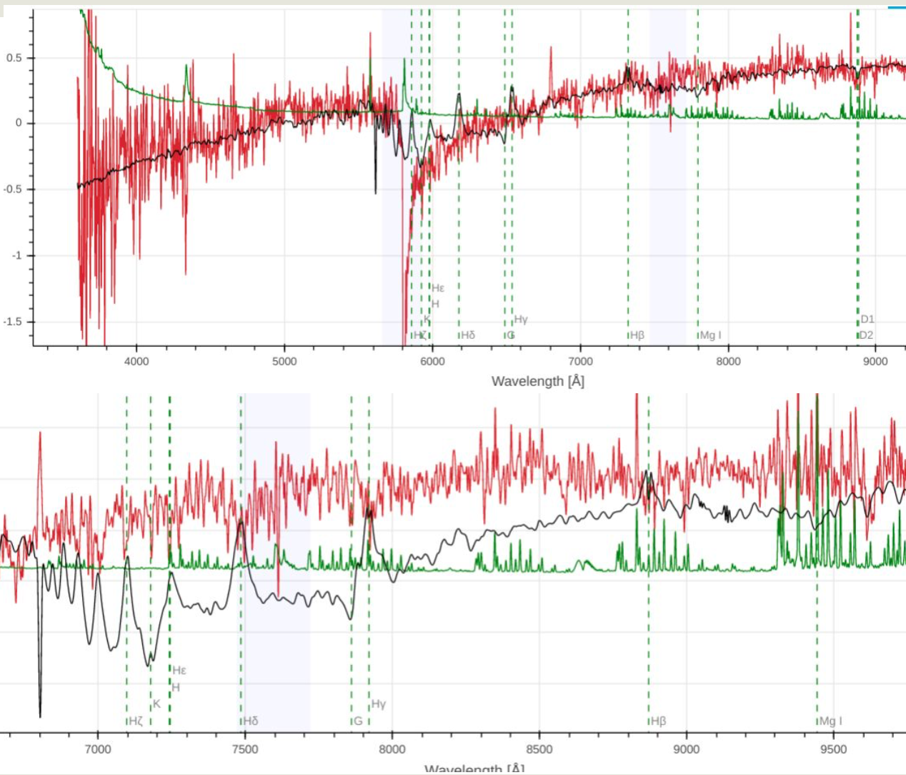
VISUALLY INSPECTING FAILURES: 5800A calibration
The top spectrum shows a miscalibration between the spectral arms at 5800A.
The light blue shaded regions in Prospect show where the spectral arms are spliced together. These overlap regions are where false steps are most likely to occur.
Redrock tried to fit an unphysical model to the strange shape in this case.
The bottom spectrum shows potentially a more subtle example at 7500A.

Slide 51
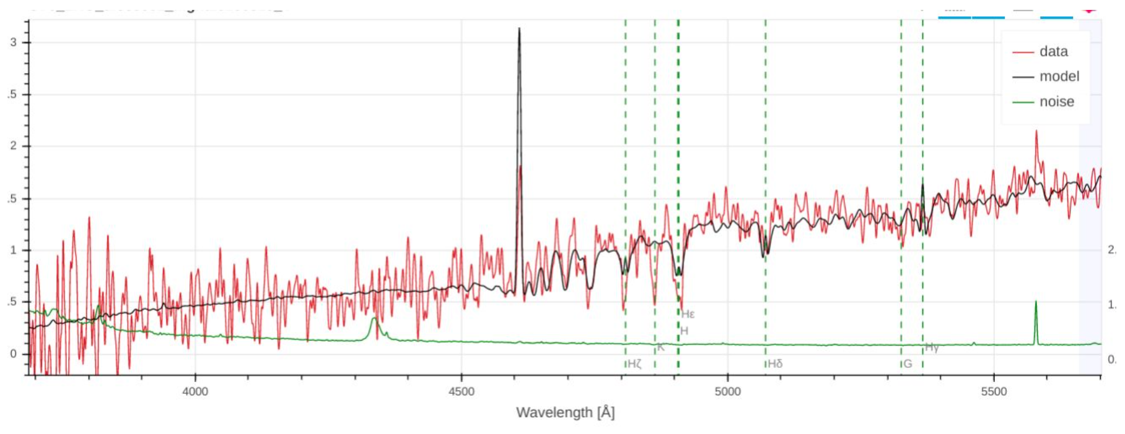
VISUALLY INSPECTING FAILURES: Ca K feature missing in model
This model (in black) is missing the Ca K feature (approx 4850A in this example). It is very rare for K to be absent when H is present (approx 4900A in this example).

Slide 52
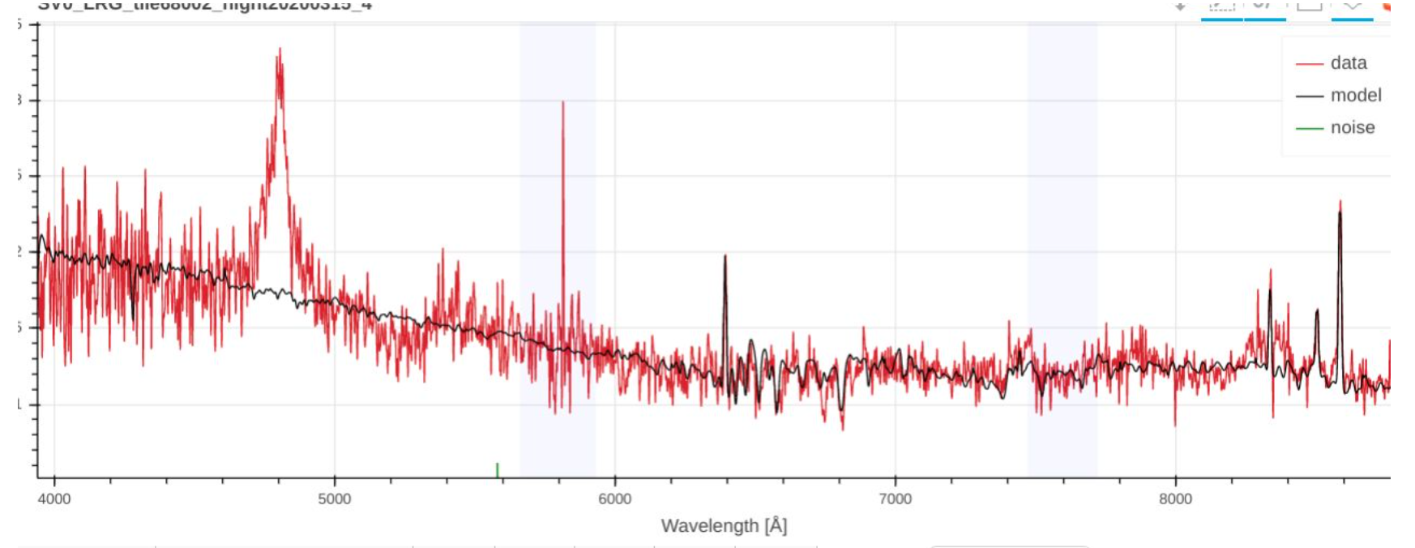
VISUALLY INSPECTING FAILURES: Missing QSO features
Redrock frequently misses QSO lines and fits only for the galaxy. Here the redshift is right, but the spectype is not. Give it a quality 4 (excellent) for the redshift, but click “bad spectype fit” and correct the spectype to QSO.

Slide 53
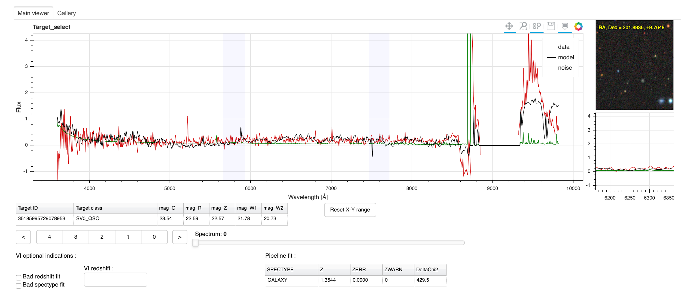
VISUALLY INSPECTING FAILURES
Reduction failed at high wavelengths. Bad spectrum.

Slide 54
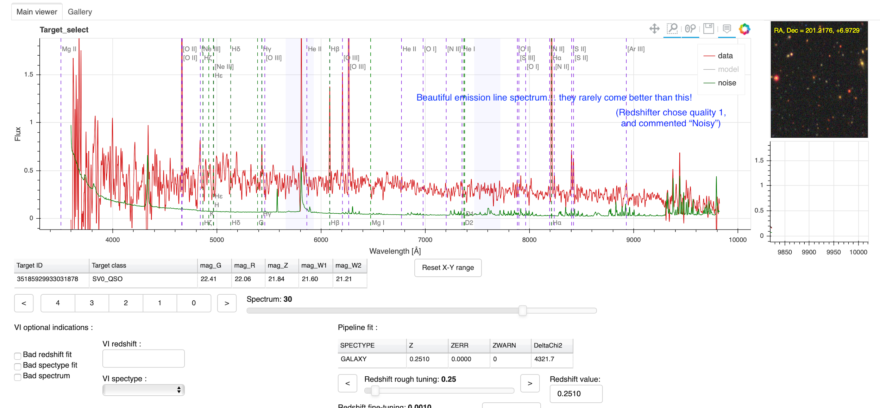
Common VI errors
...

Slide 55
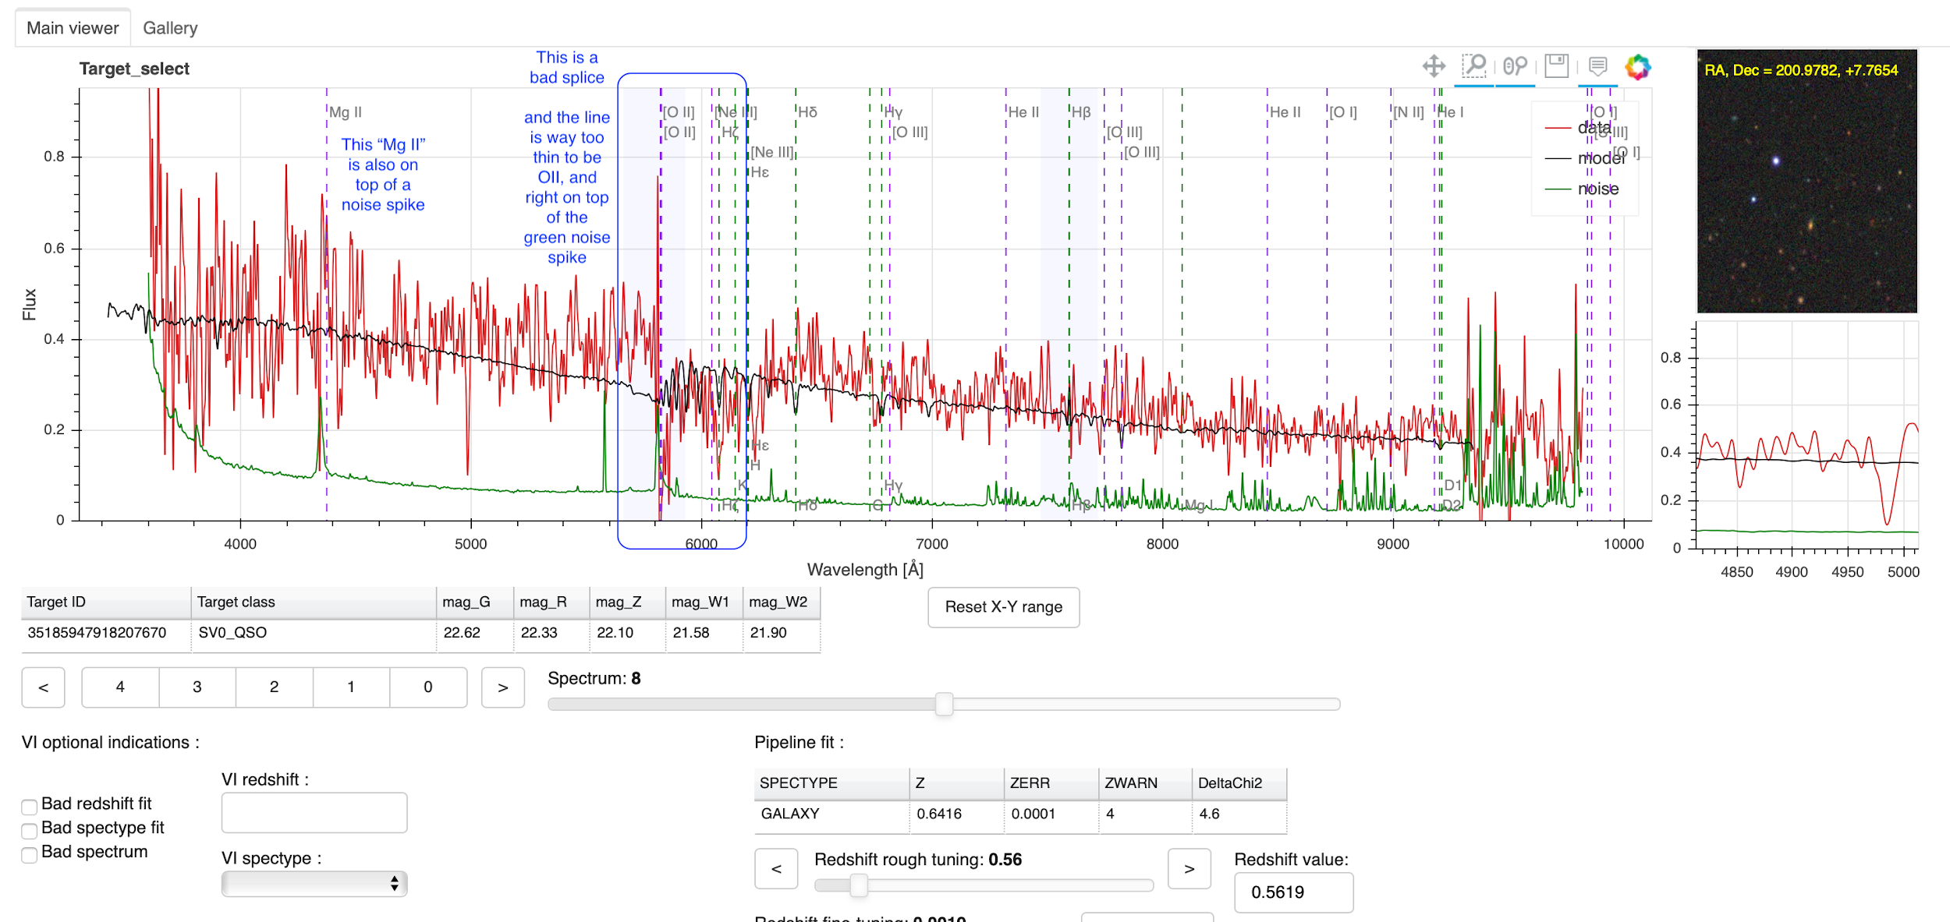
Common VI errors
...

Slide 56
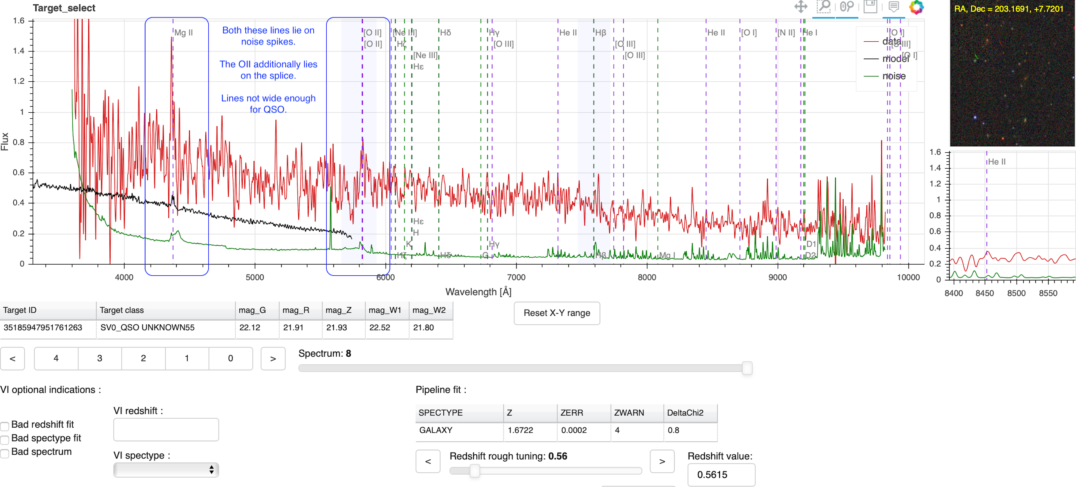
Common VI errors
...

Slide 57
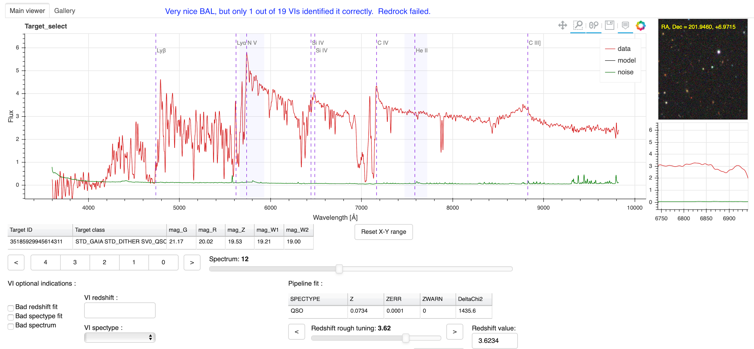
Common VI errors
Very nice BAL only 1 out of 5 VI identified
...

Slide 58
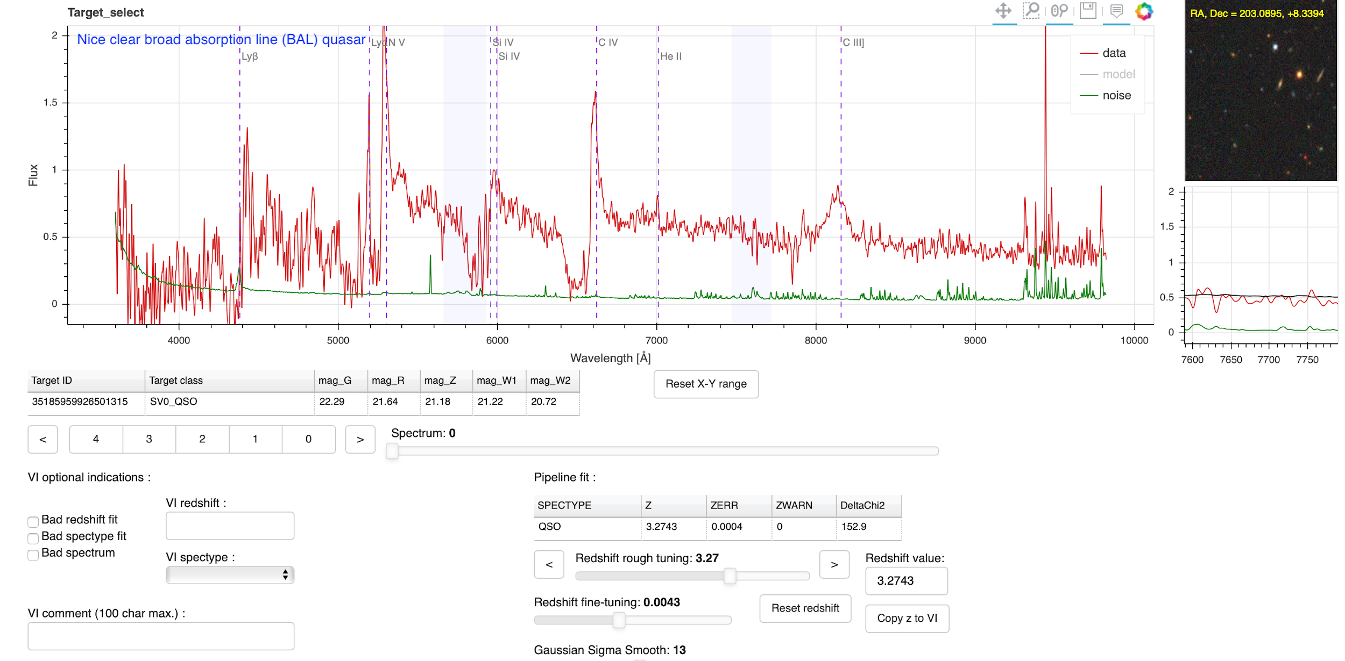
Common VI errors
Another nice Broad Absorption Line (BAL) Quasar, missed by VI.

Slide 59
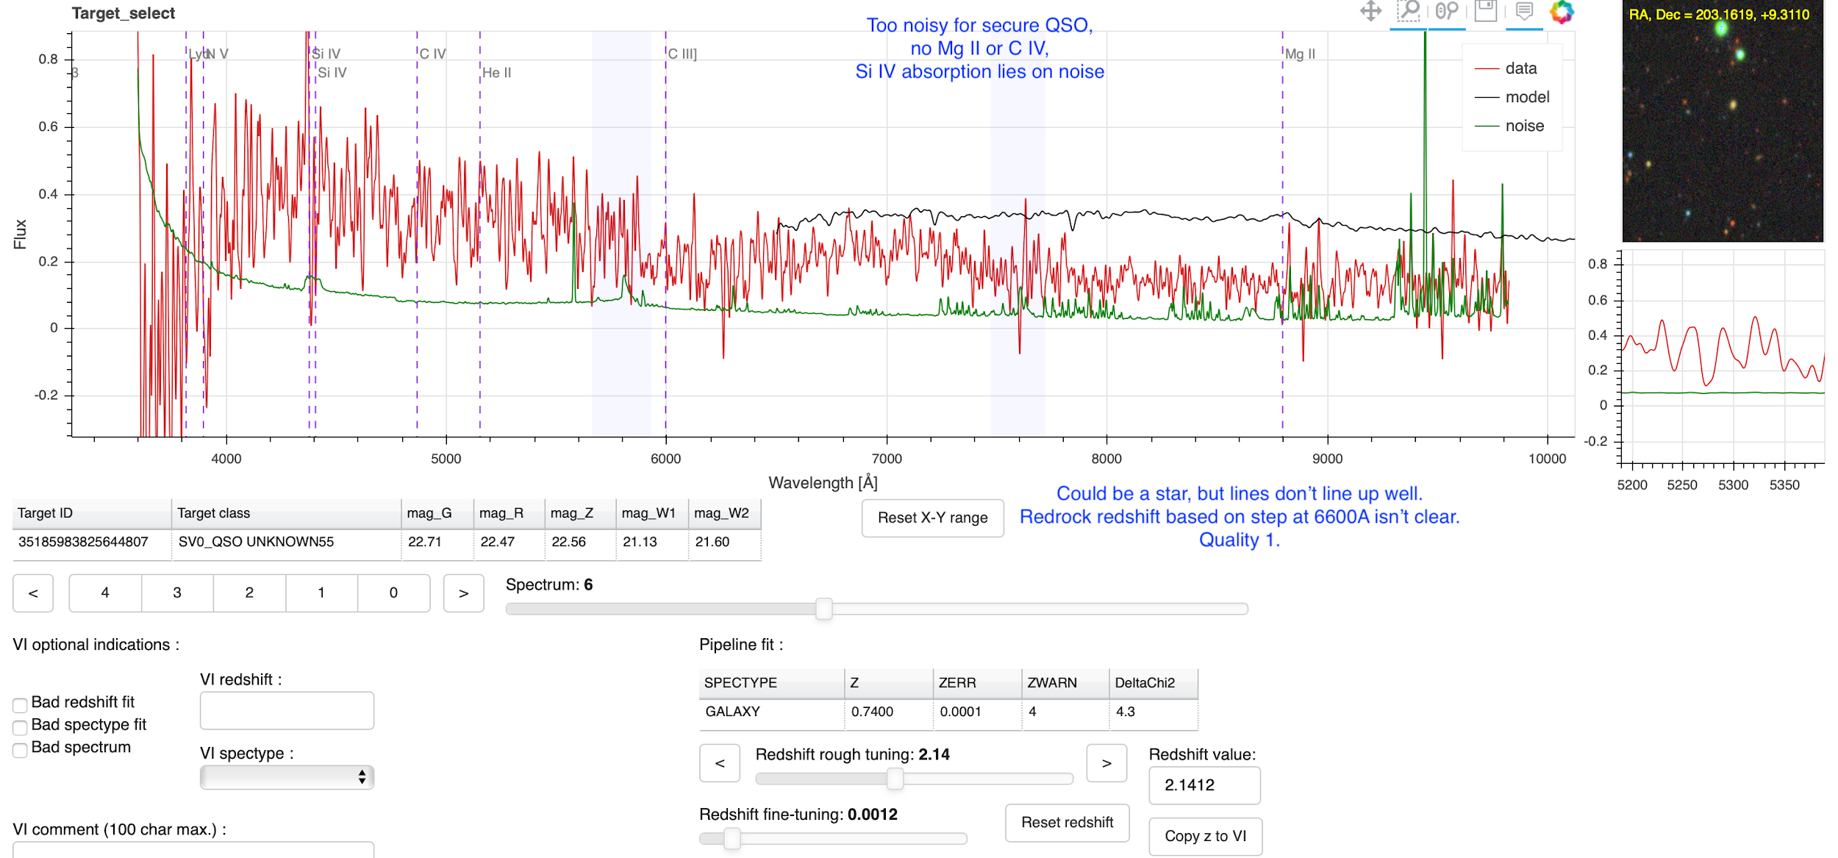
Common VI errors
...

Slide 60
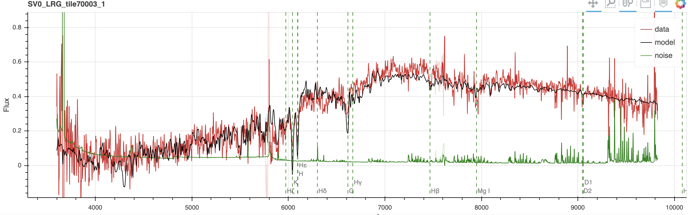
INSPECTING GALAXIES: EXAMPLES
Look for: H&K lines and continuum break.
Broad features around MgI, G-band.
Strong Hb, NaI absorption.
Watch out for a Balmer break sometimes looking like a 4000AA break.
Secure redshifts (passive)
After smoothing
2 or more secure features -> secure redshift.

